Slide 1

Prepared for HCA Corporate and
North Texas Division
Executive Leadership
April 4, 2017
HIPAA/HITECH
Training
Nursing and Patient Care Areas

Slide 2

Objectives
Participants will be able to:
Describe an overview of HIPAA and HITECH privacy key definitions and principles
Describe how HIPAA and HITECH affect job duties
List tips and guidance for applying privacy requirements
2

Slide 3
HIPAA Terminology
BAA: Business Associate Agreement
HIPAA: Health Insurance Portability and Accountability Act
HITECH: Health Information Technology for Economic and Clinical Health Act
PHI: Protected Health Information
CE: Covered Entity (Hospital, physician practice, surgery center)
ACE: Affiliated Covered Entity (Common ownership)
OHCA: Organized Health Care Arrangement (The hospital and medical staff will be considered an Organized Health Care Arrangement)
DRS: Designated Record Set (medical record and billing record)
AOD: Accounting of Disclosures (patient’s right to receive)
Directory: Hospital census list used by volunteers and operators with name and room
3

Slide 4
Hospitals are required by law to maintain the privacy of patients’ health information.
It is everyone's responsibility to ensure patient information is properly protected and safeguarded!
4

Slide 5
Facility Privacy Official (FPO)
What is a FPO?
The FPO is the “go-to” person for any
      Potential patient privacy issues
Questions on patient privacy matters
Patient privacy questions and complaints
The FPO oversees and facilitates the privacy program including all training and compliance
FPO for OU Medicine is Amber Simpson
5

Slide 6
HIPAA Definition & Purpose
What is HIPAA?
The Health Insurance Portability and Accountability Act (HIPAA) was enacted by Congress in 1996. The HIPAA Privacy Rule provides federal protections for personal health information held by covered entities and gives patients an array of rights with respect to that information.
Mandatory federal law.
What is the purpose of the law?
Protect health insurance coverage, improve access to healthcare
Reduce fraud, abuse and administrative health care costs
Improve quality of healthcare in general
6

Slide 7
How does HIPAA affect you?
Coversheets with confidential statement need to be used on all faxes
Screens will need to be placed out of public view and screensavers in use
Patient charts will need to be placed in secure area
Patient family members will give a passcode for patient information other than directory releases
All PHI (e.g., dietary slips) will need to be placed in shred containers (e.g., Shred-It bins) when disposed of
Patient information must only be accessed if there is a need to know and only the minimum necessary may be used
7

Slide 8
How does HIPAA affect you? Cont.
Registration will be giving out a Notice of Privacy Practices brochure to every patient concerning our patient privacy protection policy
Patients will be given the option to “opt out” of our directory
Patients have a right to a copy of their medical record
Authorizations need to be obtained from patient to release information for reasons other than for treatment, payment or healthcare operations (TPO) or as otherwise permitted by the HIPAA Privacy Rule
8

Slide 9
What is Protected by HIPAA?
PHI is the information pertaining to healthcare that contains any of these identifiers. People often believe that if the patient's name is removed then the information is not PHI. That is not true. There are many types of patient identifying information.
Name | Medical Record number
Address including street, county, zip code and equivalent geocodes | Health plan beneficiary number
Name of relatives | Account number
Name of employers | Certificate/license number
All elements of dates except year (DOB, admission/ discharge, expiration, etc. ) | Any other unique identifying number, characteristic or code
Telephone numbers | Web universal resource locator (URL)
Fax numbers | Internet protocol address (IP)
Email addresses | Finger or voice prints
Social Security number | Photographic images
Any vehicle or other device serial number
9

Slide 10
HITECH Definition & Purpose
What is HITECH?
The Health Information Technology for Economic and Clinical Health Act (HITECH) was signed into law by the President on February 17, 2009. It is the part of the American Recovery and Reinvestment Act(ARRA) of 2009.
It is a federal law.
HITECH Act strengthens those patient privacy protections of HIPAA and places additional requirements on the healthcare community.
What is the purpose of the law?
Makes massive changes to existing privacy and security laws
Applies to covered entities and business associates
Increases penalties for privacy and security violations
Creates a nationwide electronic health record
10

Slide 11
Key HITECH Changes
While there are many changes as a result of HITECH, some of the more substantial changes include:
Breach Notification | Restrictions
Penalties | OCR Privacy Audits
Criminal provisions | Copy charges for providing copies from EHR
Accounting of Disclosure for treatment, and health care operations in electronic health record (EHR)environment | Sharing of civil monetary penalties with harmed individuals
Business Associate Agreements | Private cause of action
Right to Access | HIPAA preemption applies to new provisions
Let’s look at some of the details of these changes.
11

Slide 12
Breach Notification
A breach is any impermissible acquisition, access, use, or disclosure of unsecured protected health information which compromises the security or privacy of such information.
HITECH provisions requires the following notifications when breaches (as defined in PHI.006) occur:
To the patient
To the Department of Health and Human Services
To the media when the breach involves more than 500 Individuals in the same state or jurisdiction
12

Slide 13
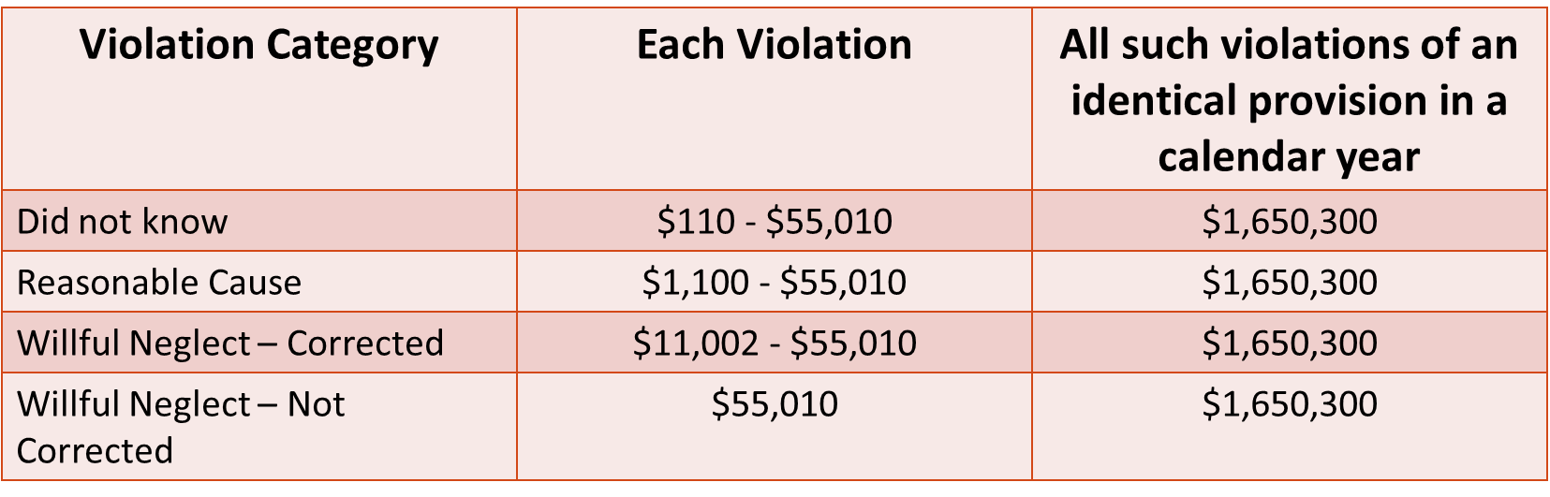
Civil Monetary Penalties for Non-Compliance*
*As of 9/06/2016
13

Slide 14
Criminal Penalties for Non-Compliance
For health plans, providers, employees, clearinghouses and business associates that knowingly and improperly disclose information or obtain information under false pretenses can be assess penalties. These penalties can also apply to any “person”.
    up to $50,000 and one year in prison for obtaining or disclosing
    protected health information (PHI)
up to $100,000 and up to five years in prison for obtaining
protected health information under "false pretenses"
up to $250,000 and up to 10 years in prison for obtaining or
disclosing protected health information with the intent to sell,
transfer or use it for commercial advantage, personal gain or
malicious harm
Penalties are higher for actions designed to generate monetary gain.
14

Slide 15
What is a Covered Entity (CE)?
A Covered Entity is any entity that is subject to HIPAA and HITECH
Health plans, health care clearing houses, and health care providers that transmit electronically for billing:
  Hospitals
Physician Practices
Insurance Companies
Ambulance transportation services
Home Health Agencies
Hospice
15

Slide 16
What does that mean to you?
You can share information without patient authorization as it relates to Treatment, Payment or Health Care Operations (TPO)
Other covered entities will request only minimum necessary to perform their job
You may request the minimal information necessary from other covered entities for reasons of TPO without patient authorization
May need to verify the requestor according to policy
16

Slide 17
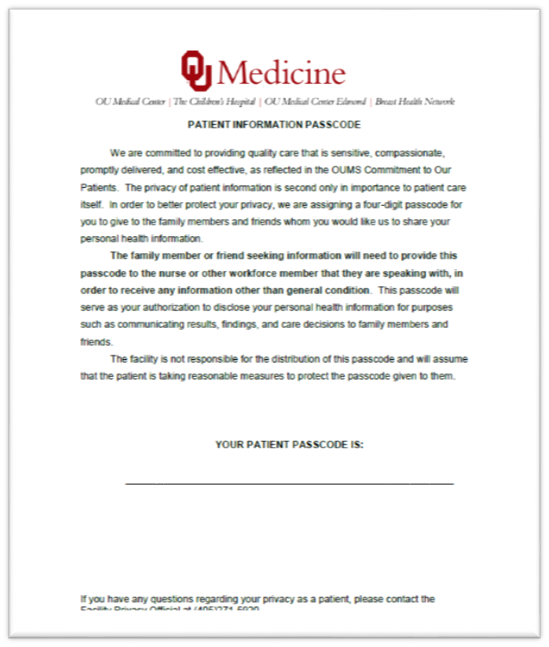

Disclosing PHI to Family Members & Friends Who Call the Unit
All patients are given a personal Patient Passcode during registration.
It is the responsibility of the patient to share their passcode with family and friends if they want the hospital to share PHI related to their condition and treatment.
Family or Friends must provide Patient Passcode to receive information other than what is provided in the facility directory.
Requests to change the Patient Passcode must be routed to the FPO.
17

Slide 18
Verification of Requestors
Verify the identity of any person or entity when the person or entity is unknown to the workforce member and is requesting PHI either in person, verbally or via written request
Individual or Patient/Patient Representative Requestors will need:
Patient SS#, DOB and one of the following:
Account number, street address, medical record
number, birth certificate, insurance card or policy
number
PHI.028 Verification of External Requestors HIPAA and PHI
18

Slide 19
Notice of Privacy Practices (NOPP)
Patient will receive NOPP upon each registration
NOPP outlines patient rights:
  Breach Notification
  Right to Access
  Right to Amend
  Fundraising and the Right to
  Opt Out
  Confidential Communication
  Right to Privacy Restriction
  Right to Opt out of Directory
19

Slide 20
Patient’s Right to Access
Forward to HIM for processing
Must be able to provide access and/or electronic or paper copy of record
If patient is in-house, HIM will manage access process
For More Information Review:
PHI.032 Patient’s Right to Access
20

Slide 21
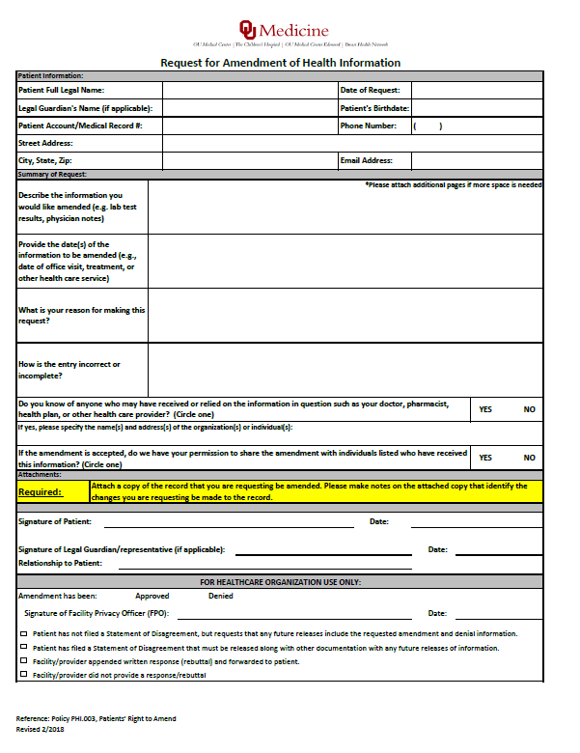
Patient’s Right to Amend
Forward request to HIM for processing
Right of patient to request amendment to records.
Request must be in writing
Cannot change or omit documentation already in the medical record
If patient is in in-house HIM will manage amendment process
21

Slide 22
Confidential Communications
Patients have the right to request for use of alternate address or alternate phone number for future contact
Route any request for Confidential Communications to Admissions
A form must be completed by the patient or patient’s legal representative
All reasonable requests must be accommodated
Should communicate only with alternate address given
22

Slide 23
Right to Privacy Restrictions
Patients have the right to request a privacy restriction of their PHI
NEVER agree to a restriction that a patient may request
All requests must be made in writing and given to the FPO to make a decision on
NO request is so small that it should not be routed to the FPO
23

Slide 24


Right to Opt Out of Directory
Patients have the right to opt out of the facility directory
Directory Disclosure – Status Change Request Form is on OUMS Intranet
You may not acknowledge the patient is in the facility or give information about the patient to friends, family or others who may inquire
Can still release information to family and friends with 4-digit passcode as defined in the Directory policy.
Forward any request for opt out to Registration for processing
PHI.021 Patients’ Right to Opt Out of Being Listed in Facility Directory
24

Slide 25
Patient Privacy Complaints
FPO must maintain complaint log in accordance with the complaint process PHI.022
ALL privacy complaints must be routed to the FPO
There may be no retaliation due to a complaint being made
Disposition of complaint must be consistent with PHI.023 Sanctions for Privacy and Security Violations policy
RL Solutions is the module used for complaint tracking
25

Slide 26
Accounting of Disclosure (AOD)
An individual has a right to receive an AOD of PHI made by a covered entity in the six years prior to the date on which the accounting is requested, except for disclosures:
Authorized by the patient | Used for law enforcement agencies that have custody of an inmate
Used for treatment, payment or health care operations | Disclosed as part if a limited data set
Released to individuals themselves | Releases that occurred before April 14, 2003
Used for national security or intelligence purposes
Additional requirements forthcoming as a result of HITECH regulations
26

Slide 27
How will Accounting of Disclosure (AOD) affect you?
You must enter information into the AOD for:
– State mandated reporting
Suspected Abuse Victims
Certain Disease reporting such as STDs
Brain Injury
– Organ and Tissue Donations
– Health Oversight Activities (The Joint Commission)
27

Slide 28


Sharing Information with Other Treatment Providers
•Patient information (PHI) can be released for reasons of treatment, payment or health care operations (TPO)
•We can share information for TPO with physicians and office staff, hospitals, or other treatment facilities for mutual patients
•Need to verify the requestor according to policy
PHI.025 Uses and Disclosures of PHI to Other Treatment Providers Under the HIPAA Privacy Standards
28

Slide 29
Safeguarding Oral PHI
Do not discuss PHI in public areas or with anyone without a need to know – even if you don’t use the patient’s name
Verify recipients of PHI prior disclosure
Ask permission to speak in front of visitors
29

Slide 30
Safeguarding Electronic PHI
Log off terminals when not in use and NEVER share your password.
PC’s should have screen savers whenever possible.
Computer screens should be positioned so information (PHI) is not readable by the public or other unauthorized viewers.
Printers should be positioned in protected locations so that printed information is not accessible or viewable by an unauthorized person.
30

Slide 31
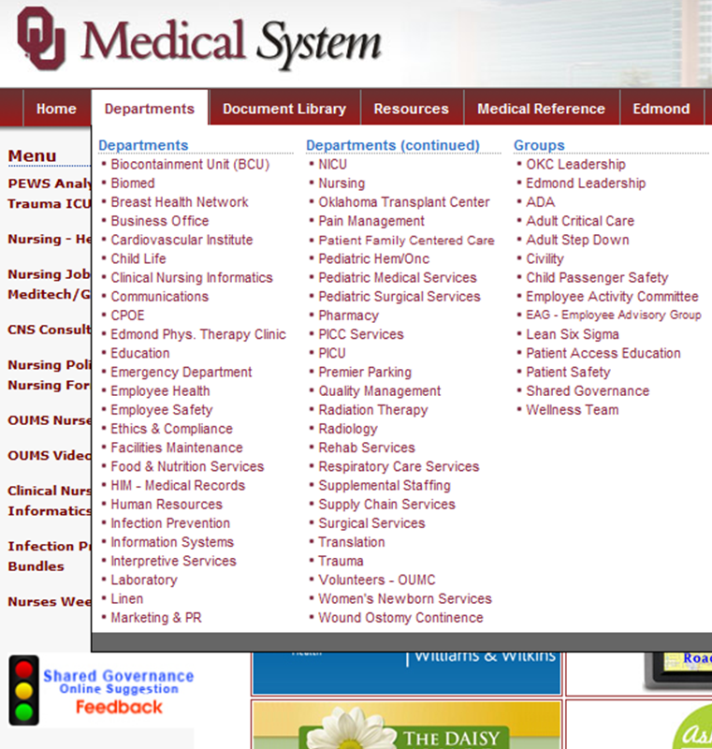
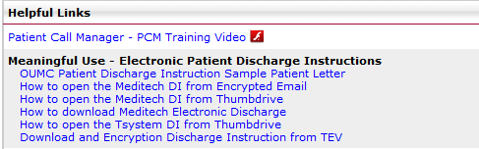
Safeguarding Electronic PHI Cont.
Encrypting PHI
Use only encrypted laptops, backup tapes, smart phones, USB drives, and other mobile devices if you must store sensitive information.
Encrypt emails if they contain sensitive information.
If a patient requests a copy of the discharge instructions electronically, make sure your encrypt it per instruction. You can find instructions on the Intranet -> Departments tab -> Nursing –> Helpful Links.
31

Slide 32
Safeguarding Paper PHI
Properly dispose of PHI in shredding bins
Patient charts will need to be placed in a secure area. Do not leave PHI in public view. Example: Charts left unattended on the counter of the nursing station
Never remove PHI from the facility unless relevant to your job function and approved by your manager
32

Slide 33
Safeguarding Faxed PHI
Limit when possible
Verify fax number
Utilize preset numbers when applicable
Fax machine located in secure location
ALWAYS use cover sheet with confidentiality statement for transmittals
Highly sensitive information should NEVER be faxed (HIV status, abuse records, etc.)
33

Slide 34
Avoid These Common Exposures
Discussions of patient information in public places such as elevators, hallways and cafeterias
Printed or electronic information left in public view (e.g., charts /Lab/X-ray results left on counters)
Radiology films in public areas
Discussing patient information on social networking sites (e.g., Facebook, Twitter)
PHI in regular trash/sharps bins
White boards/monitors with full patient name
Unauthorized individuals hearing patient sensitive information such as diagnosis or treatment
34

Slide 35
Sanctions
There is a sanctions policy to address privacy and information security violations
Types of violations can include:
– Negligent (accidental or inadvertent)
– Intentional (purposeful)
For specific information on sanctions policy contact FPO and/or review the facility’s policy
For More Information Review:
PHI.023 Sanctions for Privacy & Information Security Violations
35

Slide 36
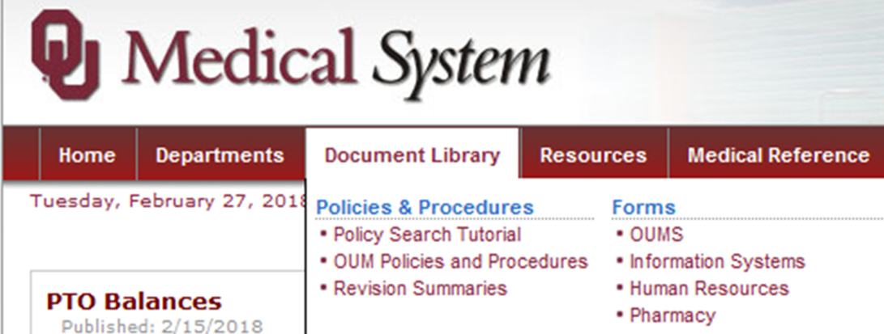

Patient Privacy Policies and Forms on the Intranet
36

Slide 37
Test Your Knowledge
Do you know who your FPO is?
What kinds of privacy rights does the patient have?
Can a patient amend their record?
Do you know who to refer patient privacy questions or complaints to?
What is an Accounting of Disclosures?
When can you access, use or disclose the patient’s PHI?
Where do you dispose of patient information?
37

Slide 38
OUM Privacy Policies
PHI.001 - Mitigating Inappropriate or Unauthorized Access, Use and/or Disclosure of Protected Health Information
PHI.002 - Protecting and Mitigating Inappropriate or Unauthorized Access, Use and/or Disclosure of Personally-Identifiable Information
PHI.003 - Patients’ Right to Amend
PHI.004 - Patients’ Right to Request Privacy Restrictions
PHI.005 - Accounting of Disclosures
PHI.006 - Protected Health Information Breach Risk Assessment and Notification
PHI.007 - Notice of Privacy Practices
PHI.008 - Safeguarding Protected Health Information
PHI.009 - Minimum Necessary
PHI.010 - Patients’ Right to Request Confidential Communications
PHI.011 - Patient Privacy Program Requirements
38

Slide 39
OUM Privacy Policies Cont.
PHI.012 - Privacy Official
PHI.013 - Fundraising Under the HIPAA Privacy Standards/HITECH
PHI.014 - Community Clergy Access to Patient Listings under the HIPAA Privacy Standards
PHI.015 - Designated Record Set
PHI.016 - Determination of Uses & Disclosures of De-Identified Info
PHI.017 - Authorization for Uses & Disclosures of PHI
PHI.018 - Hybrid Entity
PHI.019 - Limited Data Set & Data Use Agreement
PHI.020 - Marketing Under the HIPAA Privacy Standards
PHI.021 - Patient's Right to Opt Out of Being Listed in Facility Directory
PHI.022 - Privacy Complaint Process
39

Slide 40
OUM Privacy Policies Cont.
PHI.023 - Sanctions for Privacy & Info Security Violations
PHI.024 - Uses & Disclosures for which an Authorization or Opportunity to Agree or Object is not Required
PHI.025 - Uses & Disclosures of Protected Health Info to Other Covered Entities & Health Care Providers Under the HIPAA Privacy Standards
PHI.026 - Uses & Disclosures of PHI for Involvement in Patient's Care & Notification Purposes
PHI.027 - Uses and Disclosures Required by Law
PHI.028 - Uses Verification of External Requestors
PHI.029 - Electronic Incident Response
PHI.030 - Confidential Patient Status
PHI.031 - Photographing, Video Monitoring,/Recording, Audio Monitoring/Recording, and/or Other Imaging Policy
PHI.032- Patents' Right to Access
40

Slide 41
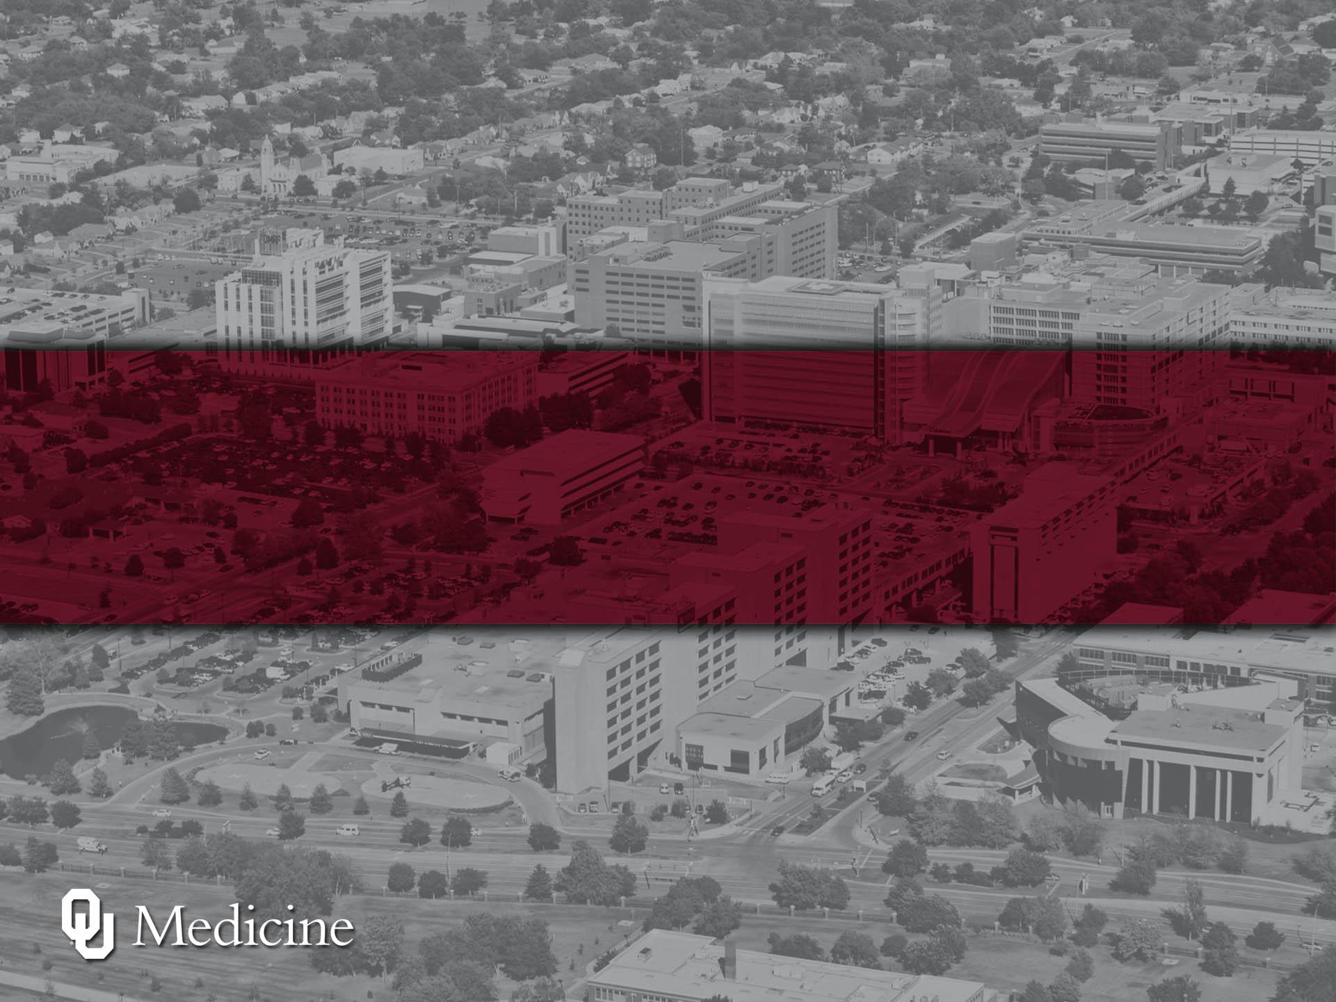
Thank you for your attention and for protecting our patient’s PHI.
Every patient, every time!

