Slide 1

Prepared for HCA Corporate and
North Texas Division
Executive Leadership
April 4, 2017
HIPAA/HITECH
Training
Clinical Non – Patient Care Areas

Slide 2

Objectives
Participants will be able to:
Describe an overview of HIPAA and HITECH privacy key definitions and principles
Describe how HIPAA and HITECH affect job duties
List tips and guidance for applying privacy requirements
2

Slide 3
HIPAA Terminology
BAA: Business Associate Agreement
HIPAA: Health Insurance Portability and Accountability Act
HITECH: Health Information Technology for Economic and Clinical Health Act
PHI: Protected Health Information
CE: Covered Entity (Hospital, physician practice, surgery center)
ACE: Affiliated Covered Entity (Common ownership)
OHCA: Organized Health Care Arrangement (The hospital and medical staff will be considered an Organized Health Care Arrangement)
DRS: Designated Record Set (medical record and billing record)
AOD: Accounting of Disclosures (patient’s right to receive)
Directory: Hospital census list used by volunteers and operators with name and room
3

Slide 4
Hospitals are required by law to maintain the privacy of patients’ health information.
It is everyone's responsibility to ensure patient information is properly protected and safeguarded!
4

Slide 5
Facility Privacy Official (FPO)
What is a FPO?
The FPO is the “go-to” person for any
      Potential patient privacy issues
Questions on patient privacy matters
Patient privacy questions and complaints
The FPO oversees and facilitates the privacy program including all training and compliance
FPO for OU Medicine is Amber Simpson
5

Slide 6
HIPAA Definition & Purpose
What is HIPAA?
The Health Insurance Portability and Accountability Act (HIPAA) was enacted by Congress in 1996. The HIPAA Privacy Rule provides federal protections for personal health information held by covered entities and gives patients an array of rights with respect to that information.
Mandatory federal law.
What is the purpose of the law?
Protect health insurance coverage, improve access to healthcare
Reduce fraud, abuse and administrative health care costs
Improve quality of healthcare in general
6

Slide 7
How does HIPAA affect you?
Coversheets with confidential statement need to be used on all faxes
Screens will need to be placed out of public view and screensavers in use
Patients will identify who their information can be discussed with, including family
All PHI (e.g., dietary slips) will need to be placed in shred containers (e.g., Shred-It bins) when disposed of
Patient information must only be accessed if there is a need to know and only the minimum necessary may be used
7

Slide 8
What is Protected by HIPAA?
PHI is the information pertaining to healthcare that contains any of these identifiers. People often believe that if the patient's name is removed then the information is not PHI. That is not true. There are many types of patient identifying information.
Name | Medical Record number
Address including street, county, zip code and equivalent geocodes | Health plan beneficiary number
Name of relatives | Account number
Name of employers | Certificate/license number
All elements of dates except year (DOB, admission/ discharge, expiration, etc. ) | Any other unique identifying number, characteristic or code
Telephone numbers | Web universal resource locator (URL)
Fax numbers | Internet protocol address (IP)
Email addresses | Finger or voice prints
Social Security number | Photographic images
Any vehicle or other device serial number
8

Slide 9
HITECH Definition & Purpose
What is HITECH?
The Health Information Technology for Economic and Clinical Health Act (HITECH) was signed into law by the President on February 17, 2009. It is the part of the American Recovery and Reinvestment Act(ARRA) of 2009.
It is a federal law.
HITECH Act strengthens those patient privacy protections of HIPAA and places additional requirements on the healthcare community.
What is the purpose of the law?
Makes massive changes to existing privacy and security laws
Applies to covered entities and business associates
Increases penalties for privacy and security violations
Creates a nationwide electronic health record
9

Slide 10
Key HITECH Changes
While there are many changes as a result of HITECH, some of the more substantial changes include:
Breach Notification | Restrictions
Penalties | OCR Privacy Audits
Criminal provisions | Copy charges for providing copies from EHR
Accounting of Disclosure for treatment, and health care operations in electronic health record (EHR)environment | Sharing of civil monetary penalties with harmed individuals
Business Associate Agreements | Private cause of action
Right to Access | HIPAA preemption applies to new provisions
Let’s look at some of the details of these changes.
10

Slide 11
Breach Notification
A breach is any impermissible acquisition, access, use, or disclosure of unsecured protected health information which compromises the security or privacy of such information.
HITECH provisions requires the following notifications when breaches (as defined in PHI.006) occur:
To the patient
To the Department of Health and Human Services
To the media when the breach involves more than 500 Individuals in the same state or jurisdiction
11

Slide 12
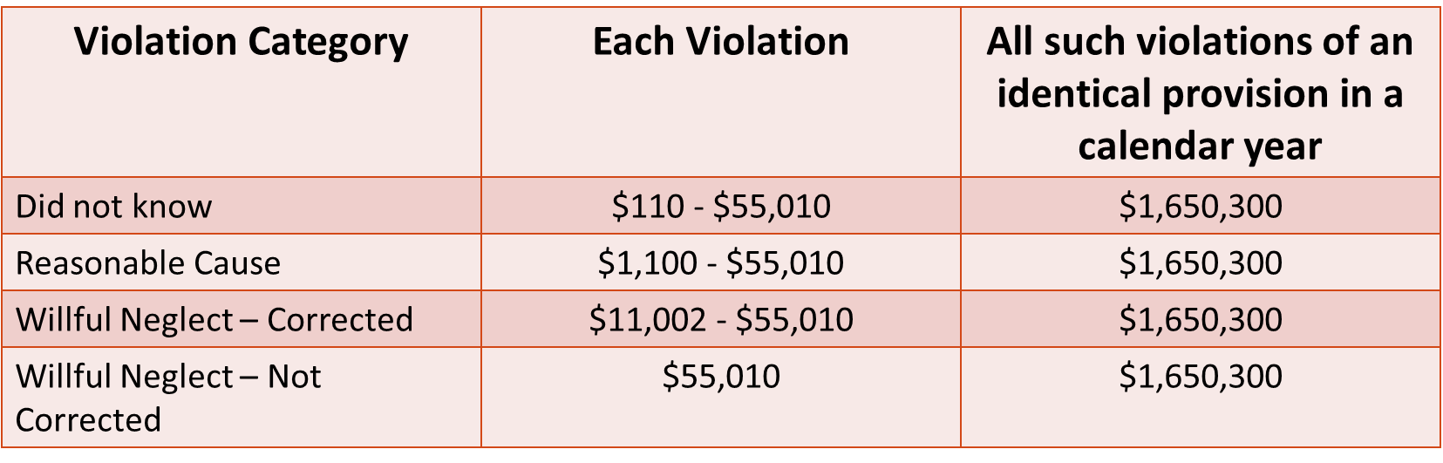
Civil Monetary Penalties for Non-Compliance*
*As of 9/06/2016
12

Slide 13
Criminal Penalties for Non-Compliance
For health plans, providers, employees, clearinghouses and business associates that knowingly and improperly disclose information or obtain information under false pretenses can be assess penalties. These penalties can also apply to any “person”.
    up to $50,000 and one year in prison for obtaining or disclosing
    protected health information (PHI)
up to $100,000 and up to five years in prison for obtaining
protected health information under "false pretenses"
up to $250,000 and up to 10 years in prison for obtaining or
disclosing protected health information with the intent to sell,
transfer or use it for commercial advantage, personal gain or
malicious harm
Penalties are higher for actions designed to generate monetary gain.
13

Slide 14
Notice of Privacy Practices (NOPP)
Patient will receive NOPP upon each registration
NOPP outlines patient rights:
  Breach Notification
  Right to Access
  Right to Amend
  Fundraising and the Right to
  Opt Out
  Confidential Communication
  Right to Privacy Restriction
  Right to Opt out of Directory
14

Slide 15
Confidential Communications
Patients have the right to request for use of alternate address or alternate phone number for future contact
If there is a failure to respond by the patient, then we may revert to permanent address or phone number
15

Slide 16
Right to Privacy Restrictions
Patients have the right to request a privacy restriction of their PHI
NEVER agree to a restriction that a patient may request
All requests must be made in writing and given to the FPO to make a decision on
NO request is so small that it should not be routed to the FPO
16

Slide 17
Patient Privacy Complaints
FPO must maintain complaint log in accordance with the complaint process PHI.022
ALL privacy complaints must be routed to the FPO
There may be no retaliation due to a complaint being made
Disposition of complaint must be consistent with PHI.023 Sanctions for Privacy and Security Violations policy
RL Solutions is the module used for complaint tracking
17

Slide 18
Examples of Exposure
Sharing of passwords
Inappropriate control or use of patient lists with PHI
Lack of knowledge regarding permitted uses of patient information
Using business agents without contracts and appropriate Business Associate Agreements
Discussing patient information on social networking sites (e.g., Facebook, Twitter)
18

Slide 19
Examples of Exposure Cont.
Sharing PHI without an authorization when one is required
Failure to act proactively to prevent, detect, or correct privacy or security breaches
PHI in the trash can
Discussing PHI with someone who does not have a need to know
19

Slide 20

Sanctions
There is a sanctions policy to address privacy and information security violations
Types of violations can include:
– Negligent (accidental or inadvertent)
– Intentional (purposeful)
For specific information on sanctions policy contact FPO and/or review the facility’s policy
For More Information Review:
PHI.023 Sanctions for Privacy & Information Security Violations
20

Slide 21
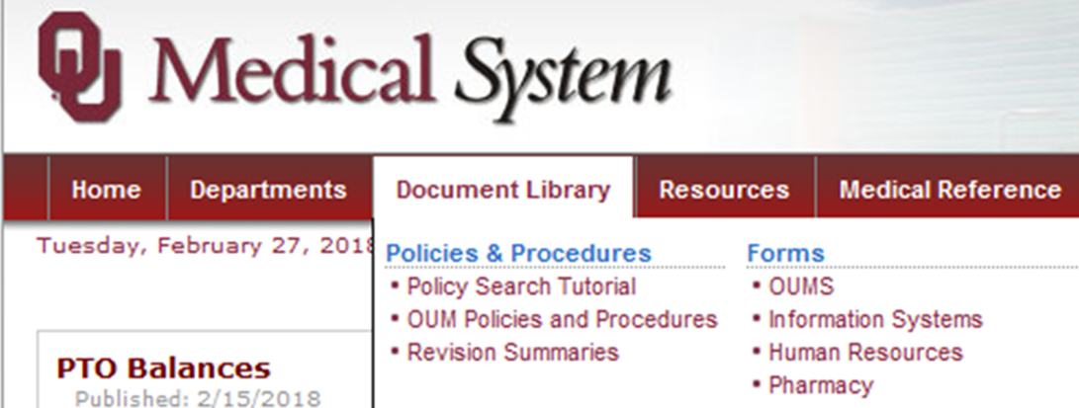

Patient Privacy Policies and Forms on the Intranet
21

Slide 22
Test Your Knowledge
Do you know who your FPO is?
What kinds of privacy rights does the patient have?
Can a patient amend their record?
Do you know who to refer patient privacy questions or complaints to?
What is an Accounting of Disclosures?
When can you access, use or disclose the patient’s PHI?
Where do you dispose of patient information?
22

Slide 23
OUM Privacy Policies
PHI.001 - Mitigating Inappropriate or Unauthorized Access, Use and/or Disclosure of Protected Health Information
PHI.002 - Protecting and Mitigating Inappropriate or Unauthorized Access, Use and/or Disclosure of Personally-Identifiable Information
PHI.003 - Patients’ Right to Amend
PHI.004 - Patients’ Right to Request Privacy Restrictions
PHI.005 - Accounting of Disclosures
PHI.006 - Protected Health Information Breach Risk Assessment and Notification
PHI.007 - Notice of Privacy Practices
PHI.008 - Safeguarding Protected Health Information
PHI.009 - Minimum Necessary
PHI.010 - Patients’ Right to Request Confidential Communications
PHI.011 - Patient Privacy Program Requirements
23

Slide 24
OUM Privacy Policies Cont.
PHI.012 - Privacy Official
PHI.013 - Fundraising Under the HIPAA Privacy Standards/HITECH
PHI.014 - Community Clergy Access to Patient Listings under the HIPAA Privacy Standards
PHI.015 - Designated Record Set
PHI.016 - Determination of Uses & Disclosures of De-Identified Info
PHI.017 - Authorization for Uses & Disclosures of PHI
PHI.018 - Hybrid Entity
PHI.019 - Limited Data Set & Data Use Agreement
PHI.020 - Marketing Under the HIPAA Privacy Standards
PHI.021 - Patient's Right to Opt Out of Being Listed in Facility Directory
PHI.022 - Privacy Complaint Process
24

Slide 25
OUM Privacy Policies Cont.
PHI.023 - Sanctions for Privacy & Info Security Violations
PHI.024 - Uses & Disclosures for which an Authorization or Opportunity to Agree or Object is not Required
PHI.025 - Uses & Disclosures of Protected Health Info to Other Covered Entities & Health Care Providers Under the HIPAA Privacy Standards
PHI.026 - Uses & Disclosures of PHI for Involvement in Patient's Care & Notification Purposes
PHI.027 - Uses and Disclosures Required by Law
PHI.028 - Uses Verification of External Requestors
PHI.029 - Electronic Incident Response
PHI.030 - Confidential Patient Status
PHI.031 - Photographing, Video Monitoring,/Recording, Audio Monitoring/Recording, and/or Other Imaging Policy
PHI.032- Patents' Right to Access
25

Slide 26
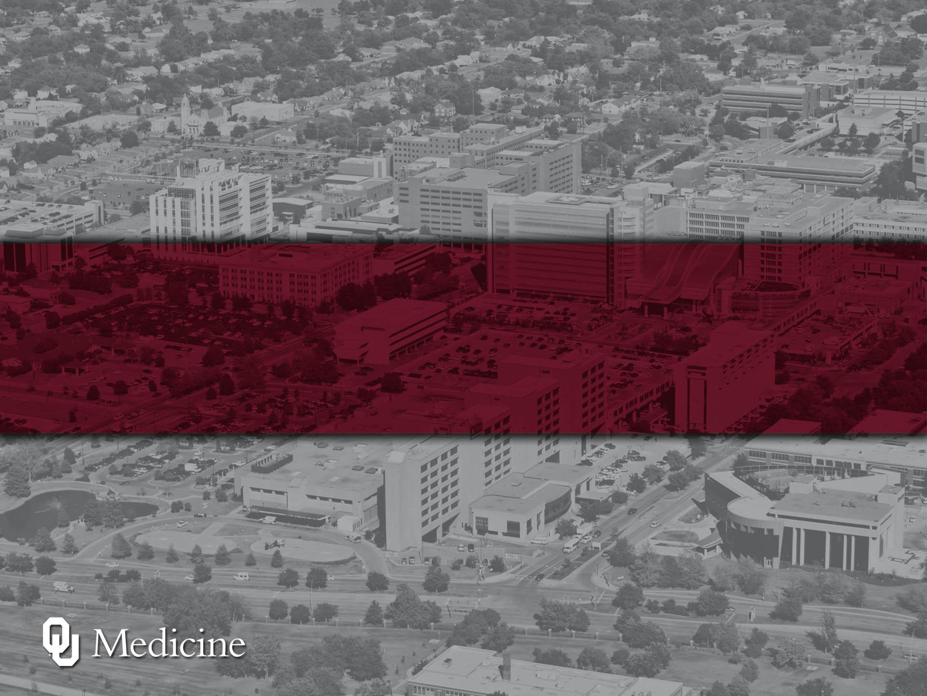
Thank you for your attention and for protecting our patient’s PHI.
Every patient, every time!

