Slide 1

Prepared for HCA Corporate and North Texas Division
Executive Leadership
April 4, 2017
EMTALA Training
For FY 2021
Presentation content by McAfee & Taft and Christy Hendricks, OUM Chief Legal Counsel

Slide 2
Emergency Medical Treatment & Active Labor Act
Federal “anti-dumping” law enacted in 1986
Purpose to ensure access to emergency services regardless of ability to pay
If patient “comes to” emergency department, hospital must perform medical screening examination to determine if emergency medical condition exists

Slide 3
Emergency Medical Treatment & Active Labor Act
If patient has emergency medical condition, provide stabilizing treatment
Transfer only if: hospital does not have capacity or capability to treat patient and benefits of transfer outweigh risks; or patient requests transfer
If no emergency medical condition exists, no further EMTALA obligations

Slide 4
EMTALA does not apply to:
Inpatients of the hospital with emergency medical conditions
Outpatients of the hospital once they are registered
The transfer of an inpatient from one hospital to OU Medicine for emergency care, specialized services, testing, or procedures
Individual screened and no Emergency Medical Condition is present
Individual presents at ED and requests treatment for non-emergency purpose or preventive care

Slide 5
Medical Screening Examinations
Perform appropriate screening based on hospital’s capability & capacity
Follow process to determine, with reasonable clinical confidence, whether patient has an Emergency Medical Condition
May follow normal registration procedures – but cannot delay Medical Screening Examination or stabilizing treatment for pre-authorization or “unduly discourage” individuals from remaining for screening

Slide 6
Emergency Medical Condition
Acute symptoms of sufficient severity (including severe pain, psychiatric disturbances and/or symptoms of substance abuse) such that absence of treatment could:
Pregnant woman having contractions (at any stage of pregnancy) has Emergency Medical Condition if:
Place health of individual in serious jeopardy; or
Cause serious impairment of bodily function; or
Cause serious dysfunction of organ or body part
Inadequate time for safe transfer before delivery; or
Transfer poses threat to health or safety to woman or infant

Slide 7
If Patient Has Emergency Medical Condition . . .
Provide necessary stabilizing treatment – medical treatment of Emergency Medical Condition so that no material deterioration of condition is likely
Provide for appropriate transfer – provide medical treatment within capability and capacity to minimize risks to patient
Woman in true labor – deliver baby and placenta or transfer appropriately

Slide 8
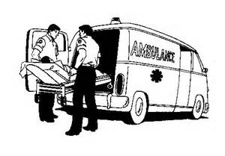
Transfers Out Permitted only …
If physician determines transfer is necessary: physician assesses benefits & risks and determines that medical benefits outweigh risks of transfer; physician must complete and sign transfer form and obtain patient signature.
If patient requests the transfer: assigned nurse will complete transfer consent form, physician explains risks and benefits, and patient signs the transfer form

Slide 9
Accepting Transfers
Hospital with specialized capabilities and capacity must accept appropriate transfers
“Capacity” - Availability of:
Beds and equipment
Availability of staff, including on-call
Not on “divert”
Past practices to accommodate patients

Slide 10
“Capability” and “Capacity”
CMS considers a hospital’s past record of accommodating additional patients by:
Determination of capacity is case-specific
If specialized or ancillary services are necessary, are they available at the receiving hospital? If so, and the hospital has capacity, then the hospital must accept.
Moving patients from one unit to another
Calling in additional staff
Temporarily borrowing equipment from other facilities
Accepting direct admissions

Slide 11
“Duty to Accept”
Generally, a hospital with “specialized capabilities” has a duty to accept transfers from hospitals without such capabilities
If physician at outlying facility determines that transfer is necessary – OU Medicine must accept transfer
Decision maker under EMTALA is always physician with “eyes on the patient” and prevails in a dispute

Slide 12
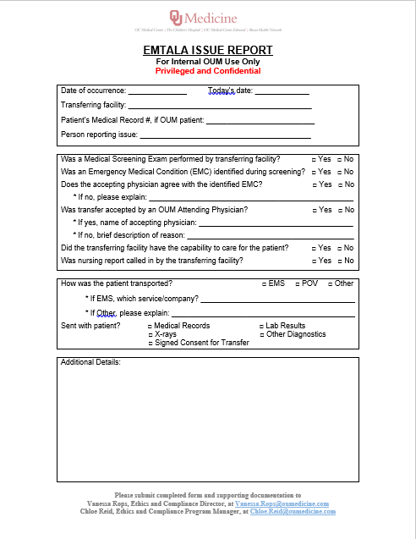
Inappropriate Transfers
If you suspect an inappropriate transfer:
Follow company policy, EMS.005, and duty to report to the Ethics and Compliance Department
Complete the EMTALA Issue Report Form and send it to the Ethics and Compliance Team
EMTALA Issue Report Forms are located in the EMTALA section of the Ethics & Compliance Intranet Page.

Slide 13
OU Medicine Policy
Only the CEO, Administrator-on-Call (“AOC”), or a hospital leader who routinely takes administrative call has authority to verify that the facility does not have the capability and capacity to accept a transfer
Any transfer request which may be declined must first be reviewed with this hospital leader before final decision to refuse acceptance is made
This requirement applies to all transfer requests, regardless of whether the transfer request is facilitated by a Transfer Center representative or the facility’s CEO designee or ED physician.
For purposes of this requirement, a Nursing Supervisor, House Supervisor or other similarly titled position is not considered equivalent to the AOC. (EMS.005)

Slide 14
Related EMTALA Obligations
A hospital cannot take adverse action against (a) physician for refusing to authorize the transfer of patient with Emergency Medical Condition that has not been stabilized; or (b) any employee who reports a violation
An inappropriate transfer is not justification for refusing to accept the patient
Follow hospital policy and duty to report to compliance (EMS.005)

Slide 15
On-Call Physicians
Hospital must maintain on-call list
“In accordance with resources available to the hospital”
Physicians must be listed individually; ED physician must have direct access to on-call physicians

Slide 16
Call Policies & Procedures
If requested by ED, on-call physician must respond in person within 30 minutes as set by your medical staff bylaws
Refer to policy and procedures if:
Particular specialty not available due to circumstances beyond his/her control

Slide 17
“Eyes on the patient””
Decision maker under EMTALA is always physician with “eyes on the patient”
If OU Medicine ED physician asks on-call specialist to respond in person, on-call specialist must do so
Issues regarding appropriateness of on-call physician being called – must handle internally after the fact

Slide 18
Enforcement
EMTALA is enforced through complaints and self-reporting
State Department of Health, CMS (and possible referral to OIG)
Administrative process before any sanctions
Civil monetary penalty factors:
Degree of culpability of hospital
Seriousness of patient’s condition
Other EMTALA violations by hospital
Financial condition of hospital
Nature and circumstances of violation

Slide 19
Potential Sanctions - Hospital
Negligently violates EMTALA – OIG imposes civil monetary penalty of up to $104,826 per violation
CMS may terminate hospital’s Medicare provider agreement (very rare)
Individual who suffers personal harm as direct result of violation may bring action against hospital
Hospital suffers financial loss as direct result of another hospital’s violation can bring civil action

Slide 20
Potential Sanctions - Physicians
If responsible for examination, treatment, or transfer and negligently violates EMTALA – civil monetary penalty of up to $50,000 per violation
On-call physician who fails to respond in person or within reasonable time
Gross, flagrant, or repeat violation – exclusion from Medicare

Slide 21
Case Scenario #1
A 60-year-old woman presents to a community hospital ED with hematemesis shortly after midnight. The ED physician suspects acute variceal gastrointestinal bleeding and requests to admit the patient under the hospitalist service. The hospitalist calls the on-call gastroenterologist to come and evaluate the patient. The gastroenterologist says he is tired and has a full day of procedures tomorrow. He says, “If the patient is that ill, you need to send her to the university hospital,” then hangs up.

Slide 22
Case Scenario #1 - Analysis
In this case, the gastroenterologist is on call and if he can treat variceal bleeding and has the hospital privileges for the procedure, then he is clearly violating the EMTALA by not doing so. Not only the hospital but the on-call gastroenterologist is subject to civil monetary penalty and sanctions.
If a physician is listed as on call and is asked to make an in-person appearance to evaluate and treat an individual with an EMC, the physician must respond in person in a reasonable amount of time. EMTALA applies to consulting and admitting physicians as well as ED physicians.

Slide 23
Case Scenario #2
A 75-year-old woman with stage 4 chronic kidney disease is dismissed by Nephrologist A from his practice because of lack of payment and no-shows. This patient is now being followed by Nephrologist B from a competing medical group. Tonight, she presents to the ED not feeling well along with nausea and vomiting. Evaluation reveals end-stage renal failure and hyperkalemia not responding to standard treatment. The ED physician calls Nephrologist A (listed as on call for the hospital). He replies back saying, “I am on call for my group only, and besides, I am not going to come at 11 p.m. to see a patient I dismissed from my practice.”

Slide 24
Case Scenario #2 - Analysis
In this case, Nephrologist A may be in violation of EMTALA and subject to penalty and sanctions.
If a physician is on call for a hospital, that means she or he is an on-call doctor for the hospital, not for her or his group alone. Exceptions include hospitals with physicians from competing groups on call for the same specialty at the same time, so all physicians should familiarize themselves with the call structure at their hospitals.

Slide 25
Case Scenario #3
A 45-year-old man presents to a rural hospital's ED with acute respiratory failure secondary to a flare-up of interstitial lung disease. The ED physician requests a transfer to a tertiary hospital for a higher level of care. The on-call physician at the tertiary hospital refuses, saying that there are other, closer hospitals that should be called instead.

Slide 26
Case Scenario #3 - Analysis
If the larger institution has empty beds and is capable of taking care of the patient, the transfer should be accepted. The on-call hospitalist who said the patient should be transferred to another hospital may be found to be in violation of EMTALA.
Refusal to accept a valid transfer from another hospital is an EMTALA violation. There is no EMTALA rule stating that the closest facility must be contacted for transfer.

Slide 27
OUM EMTALA Policies
EMS.001-EMTALA Signage
EMS.002-EMTALA Provision of On-Call Coverage
EMS.003- ETMALA Provision of Central Log
EMS.004-EMTALA Medical Screening Examination and Stabilization
EMS.005-EMTALA Transfer
EMS.006-EMTALA Definitions and General Requirements

Slide 28

Questions?
Contact:
Chloe Reid
EMTALA Internal Compliance Manager
Telephone: 405-271-0990
Email: chloe.reid@oumedicine.com

